Slide 1
SUBMITTED TO: BINOD KUMAR MISHRA DR.KAILASH CHANDRA BANDHU
MEDI-CAPS UNIVERSITY
DEPARTMENT: COMPUTER SCIENCE AND ENGINEERING
PROJECT WORK 2
(CS3PC02)
INTERNSHIP FROM:
TCS
SUBMITTED BY:
EN18CS301127 KHYATI PARMAR

Slide 2
Index
About TCS- Company Profile
About Project
What is Salesforce?
Data Security
Permission-Set Groups
Lightning Experience Customization
Customize a Salesforce Object
Tasks Done

Slide 3
About TCS
Tata Consultancy Services is an Indian multinational information technology services and consulting company.
TCS is the largest IT services company in the world by market capitalization.
As global leaders in IT services, digital and business solutions, they partner with clients to simplify, strengthen, and transform their business.
5 values of TCS: Integrity, Responsibility, Excellence, Pioneering, and Unity.
Website: www.tcs.com

Slide 4
About Project
Project Title: Cummins.
Technology Used: Salesforce Technology.
Salesforce is a famous American cloud-based software company that provides CRM services. Salesforce is a popular CRM tool for support, sales, and marketing teams worldwide.

Slide 5
Data Security & Permission Sets
The four levels at which you can control data access.
You can control which users have access to which data in your whole org, a specific object, a specific field, or an individual record.
With permission set groups, you can bundle permission sets together based on a job function.
A permission set group includes all permissions in the permission sets. You can even include a permission set in more than one permission set group.
Granting permissions to users based on the tasks they perform in their different job functions becomes much simpler.

Slide 6
Lightning Experience Customization
Lightning Salesforce is a modern, fast, and intelligent user interface.
It is built with a sales-centric mindset, focusing on helping sales representatives work more naturally on a daily basis.
With Lightning Experience, Salesforce users will get an intuitive and intelligent user interface.
Lightning Experience is built with proven Salesforce1 Mobile App technology.

Slide 7
Customize a Salesforce Object
Create new custom fields to meet business requirements and facilitate accurate data entry with formulas, picklists, and lookups.
Ensure users have access to the right fields with page layouts.
Manage multiple business scenarios with record types and business processes.
Maintain data quality with history tracking and data validation.

Slide 8
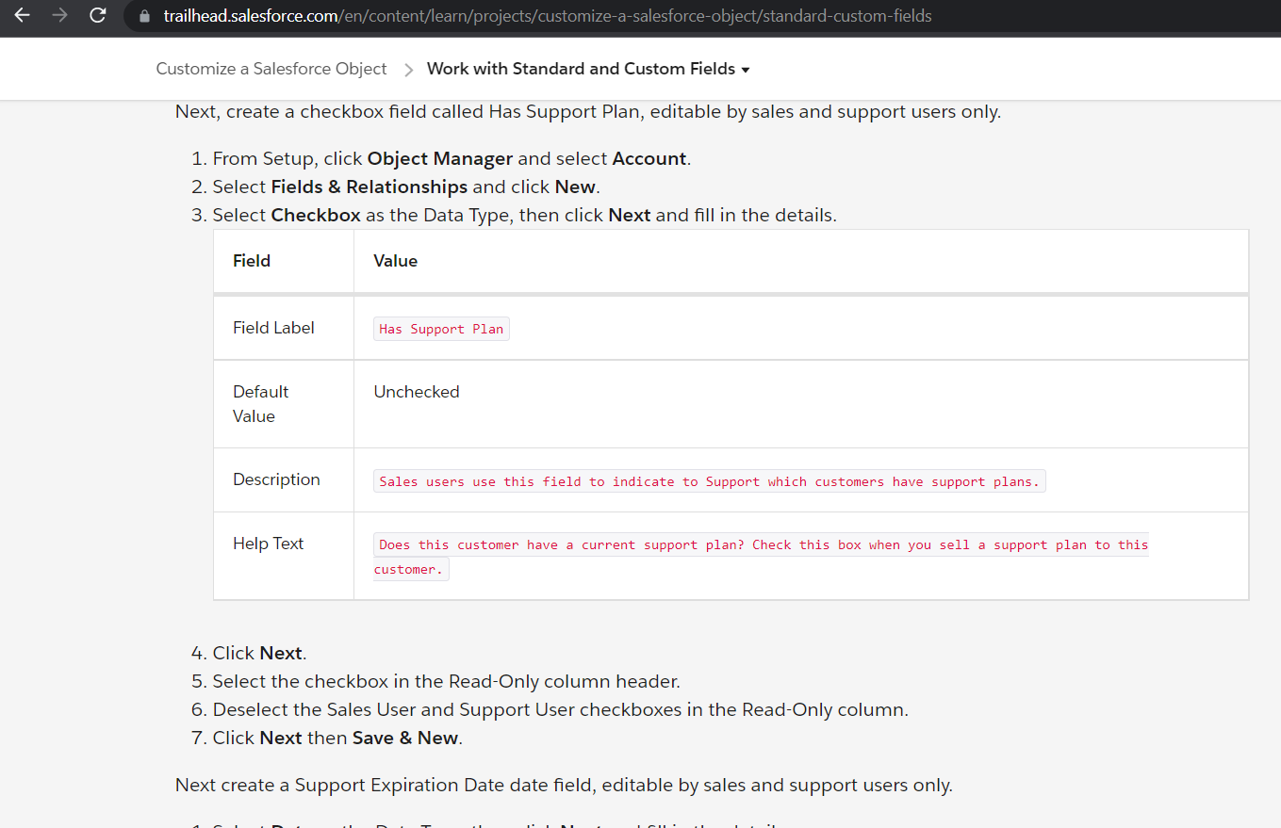

Slide 9
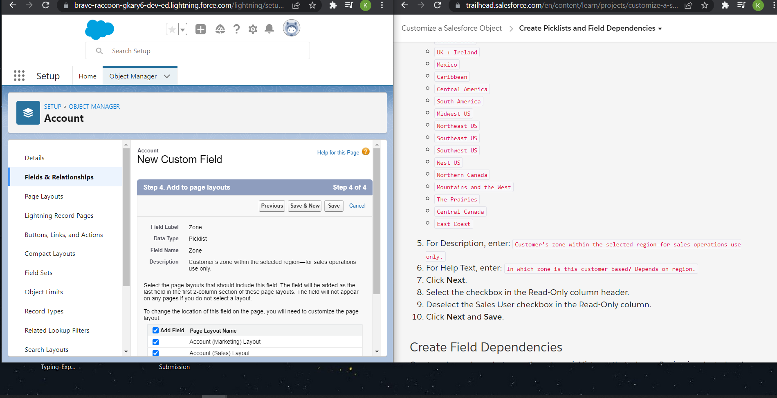

Slide 10
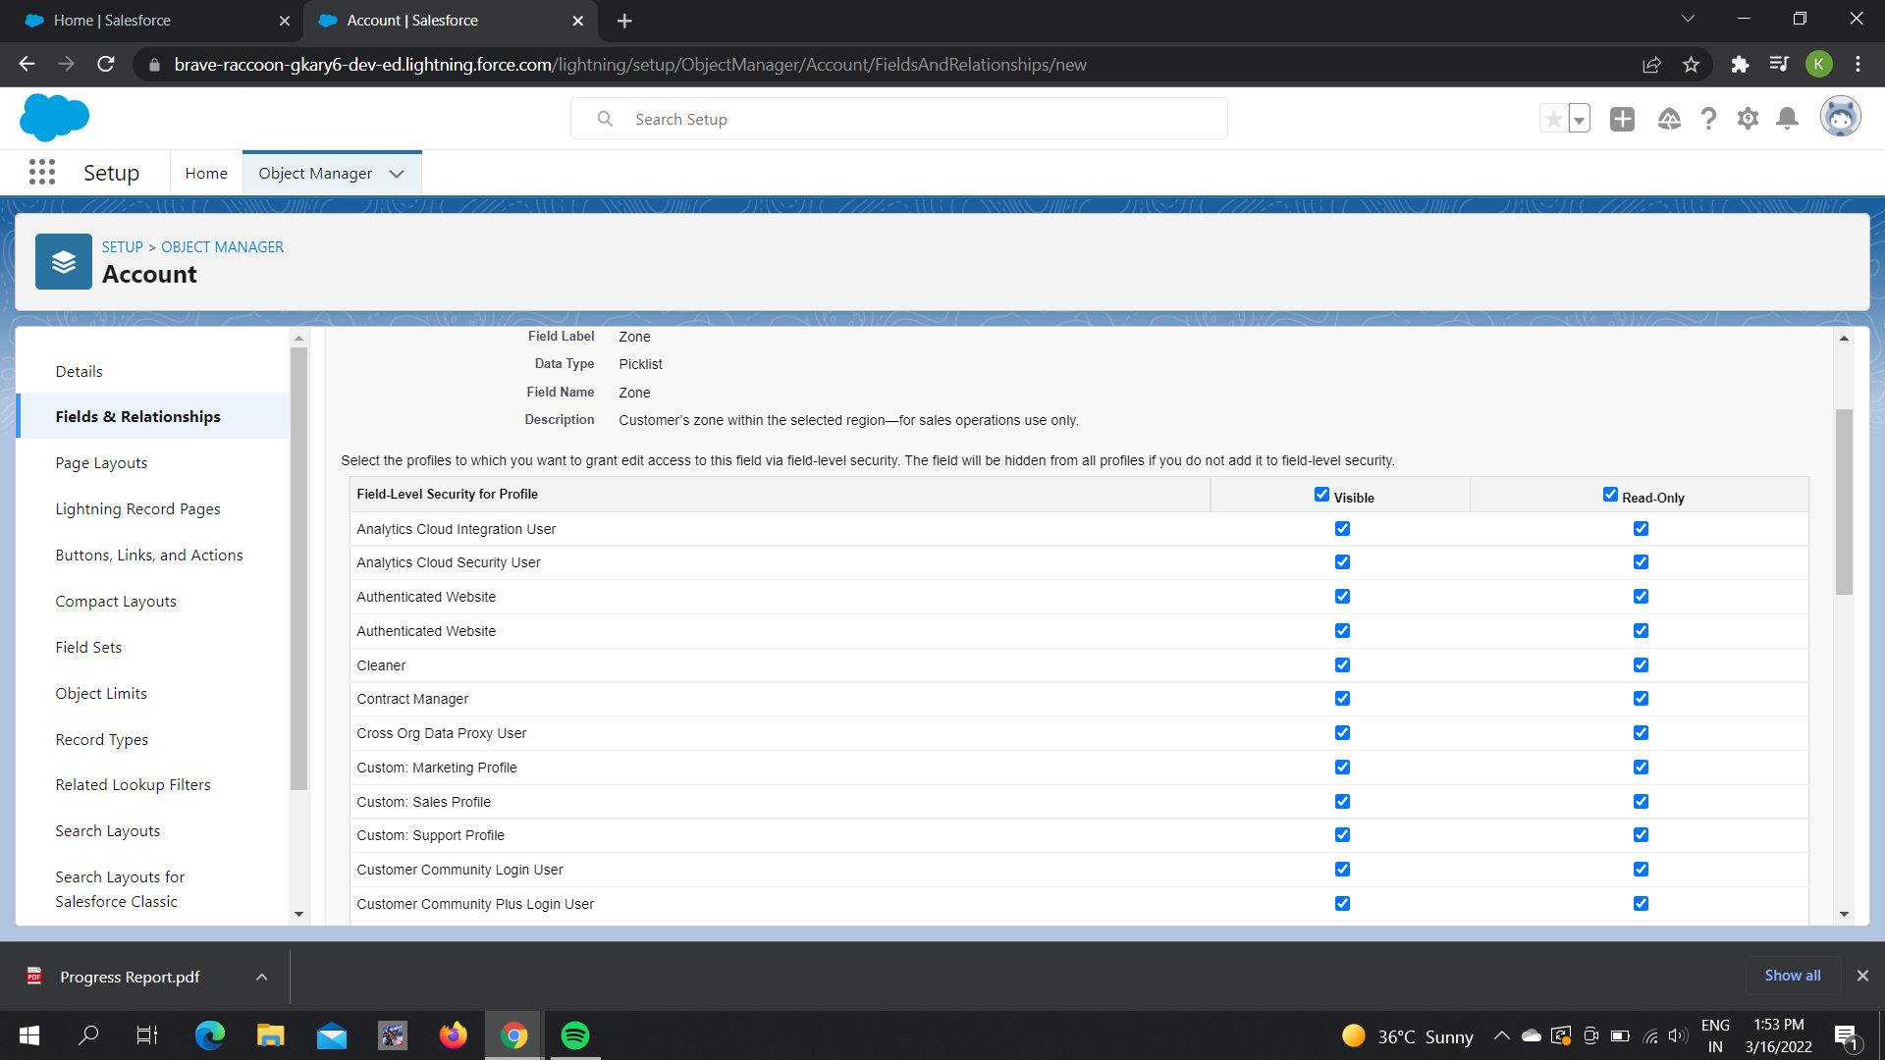
Create field Dependeiences

Slide 11
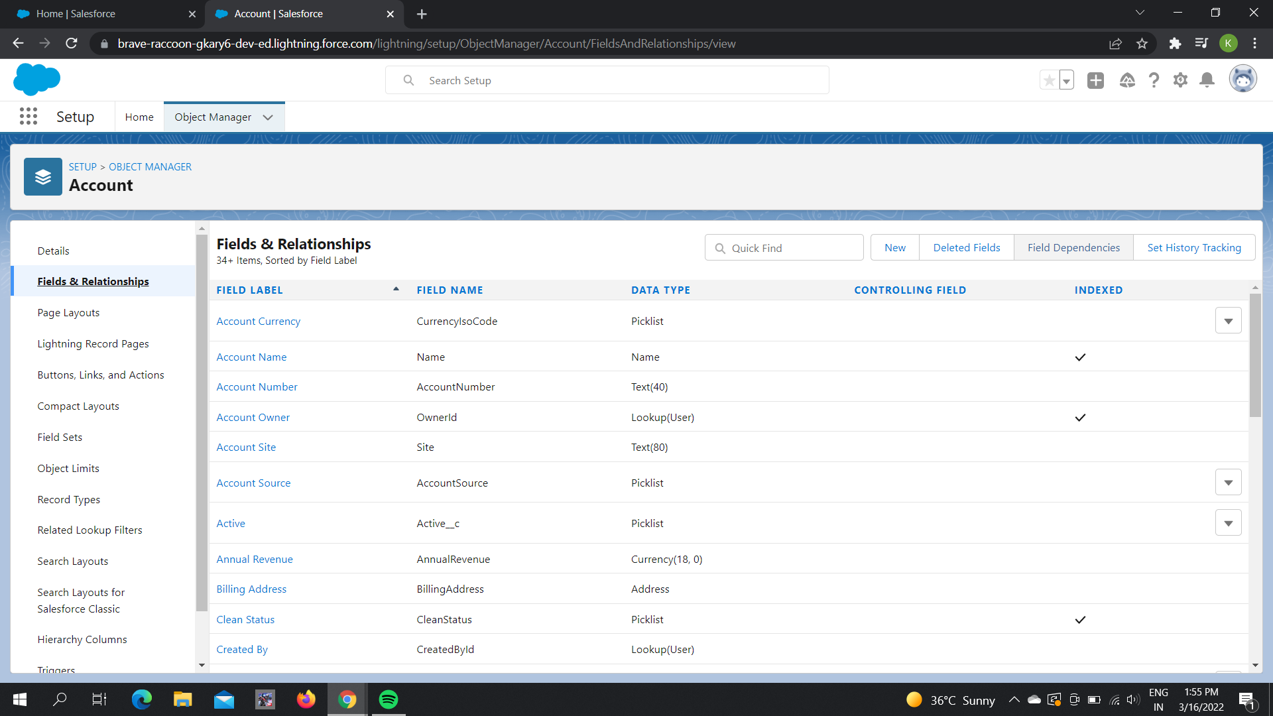

Slide 12
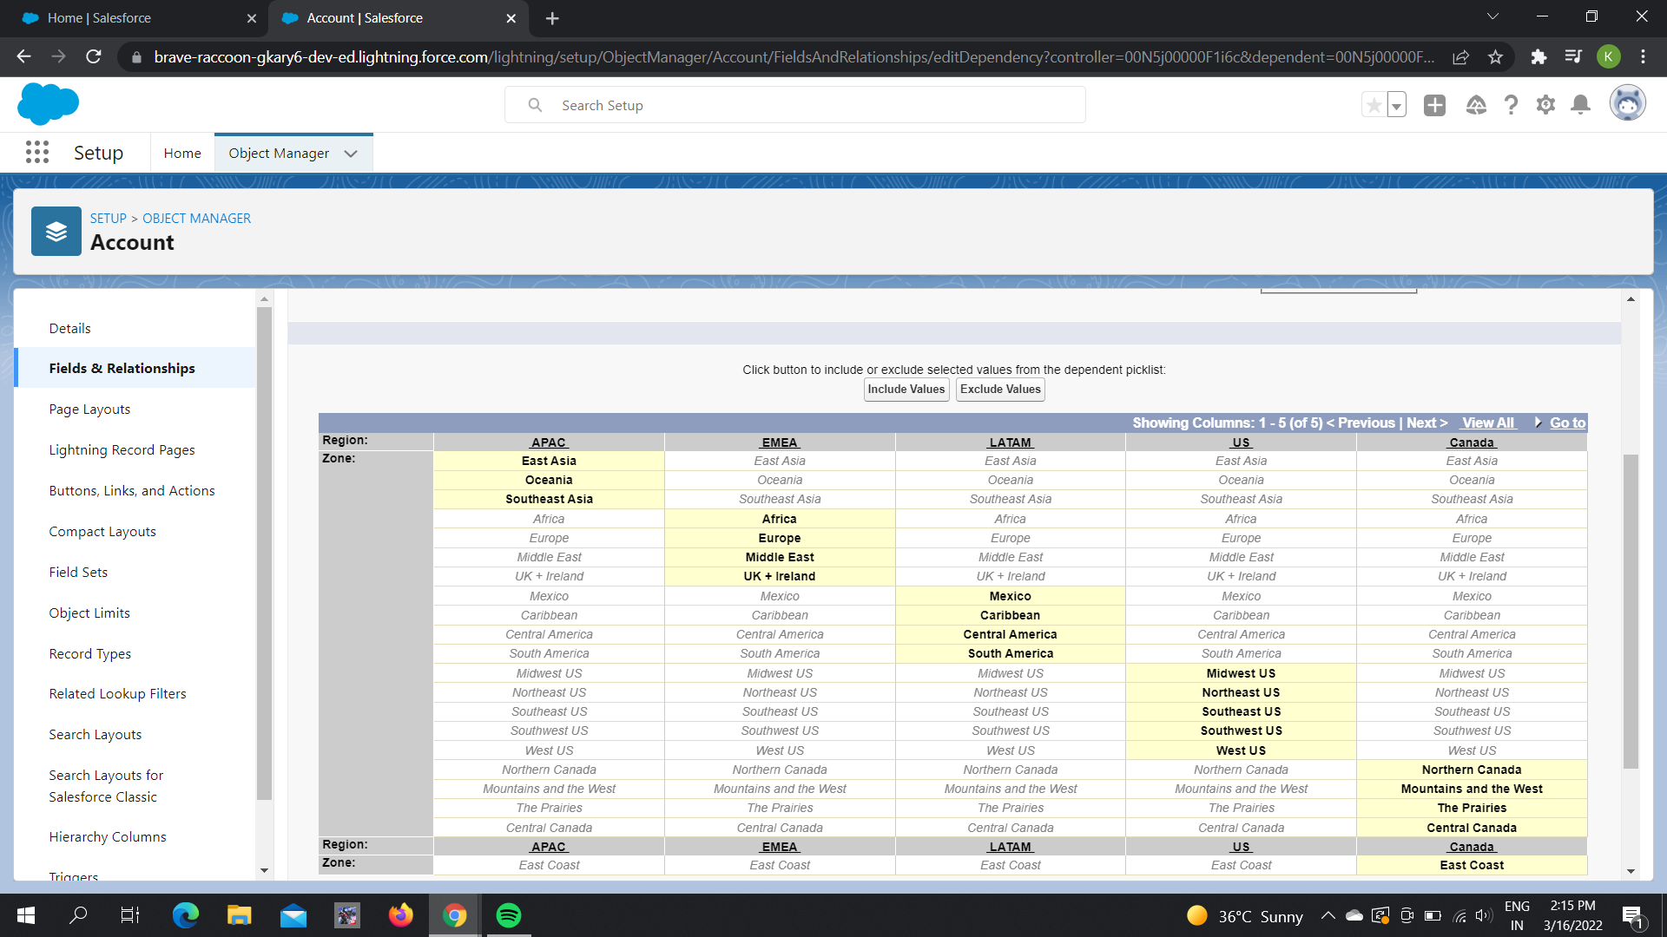

Slide 13
Tasks for Customize a Salesforce Object- Create Lookup Filters

Slide 14
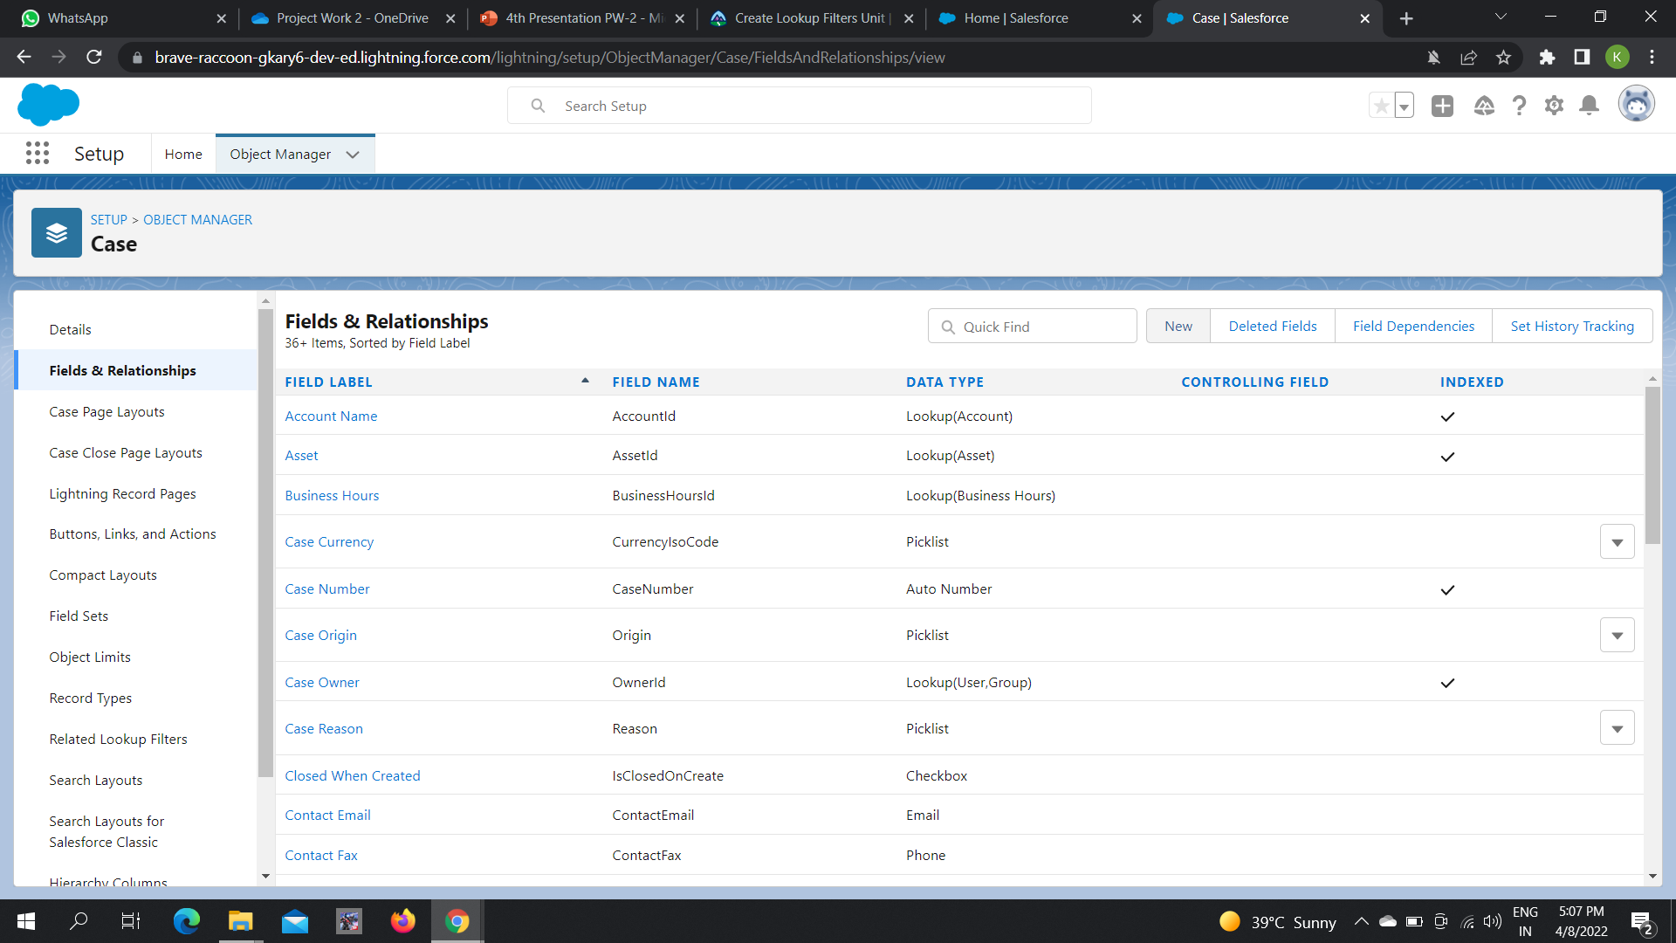

Slide 15
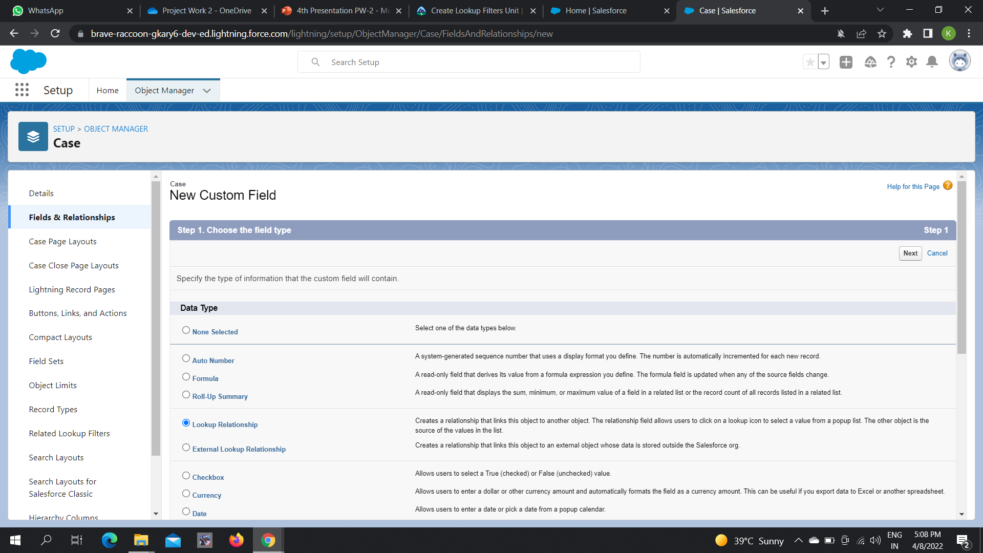

Slide 16
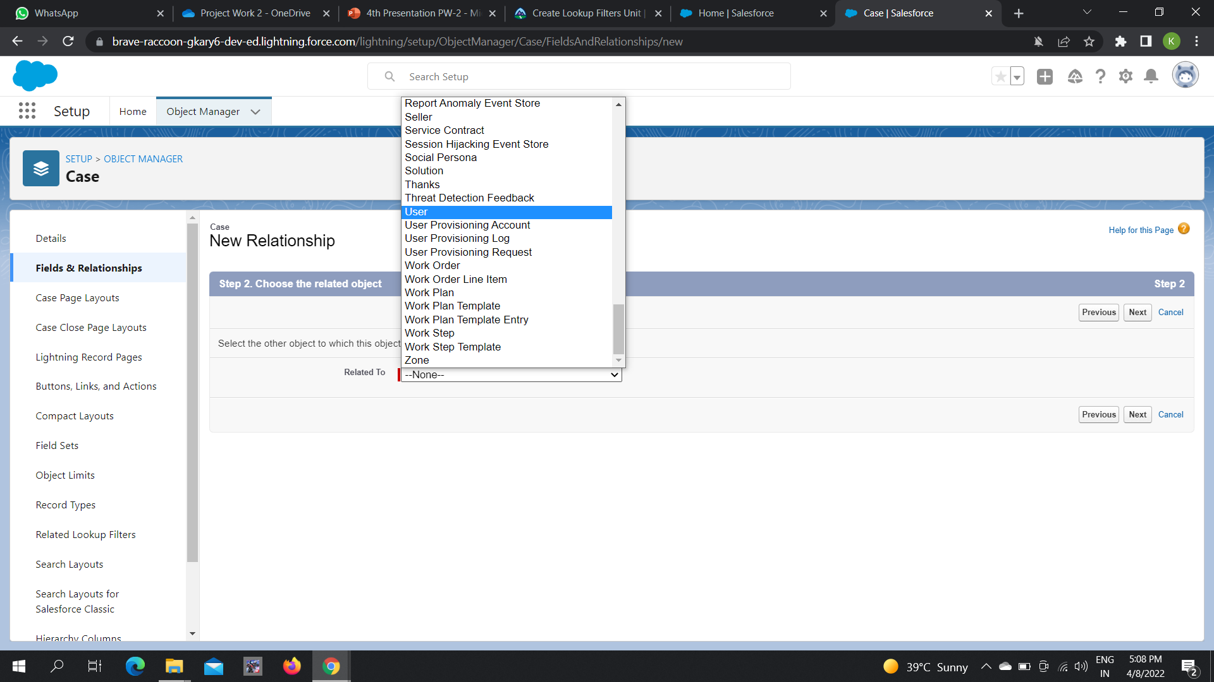

Slide 17
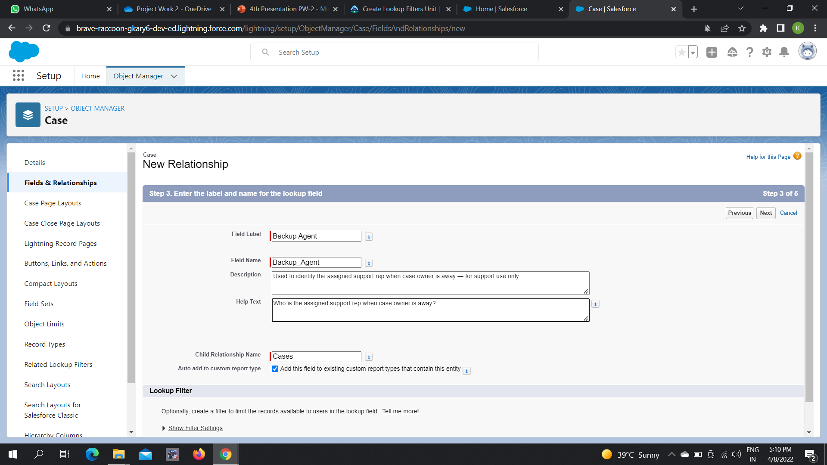

Slide 18
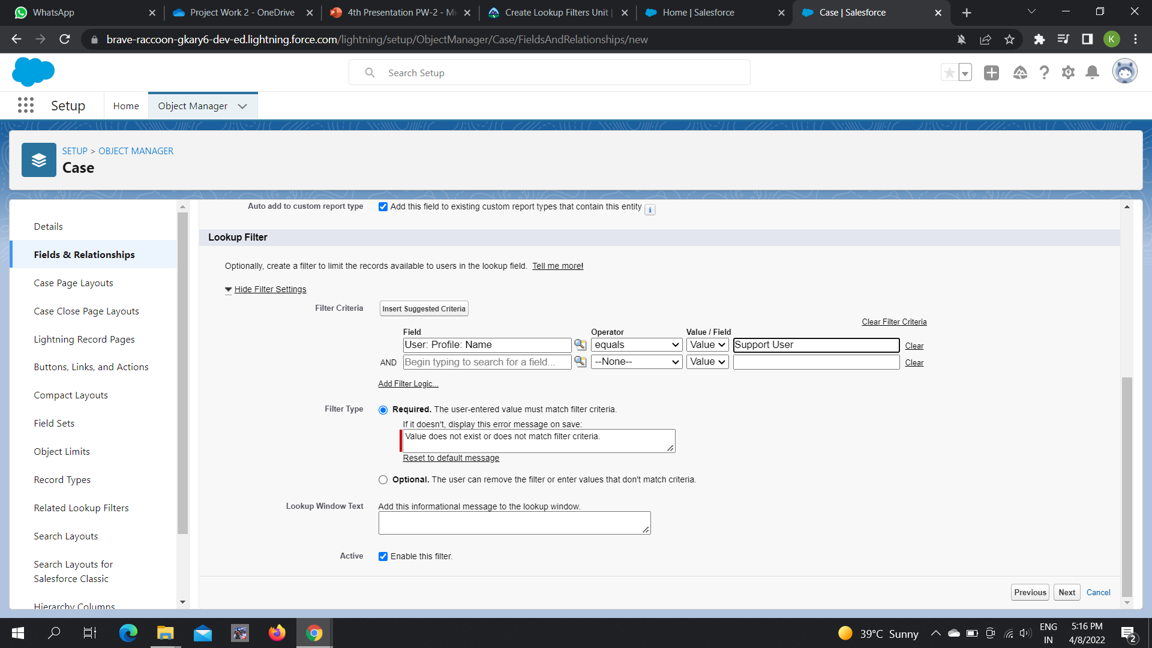

Slide 19
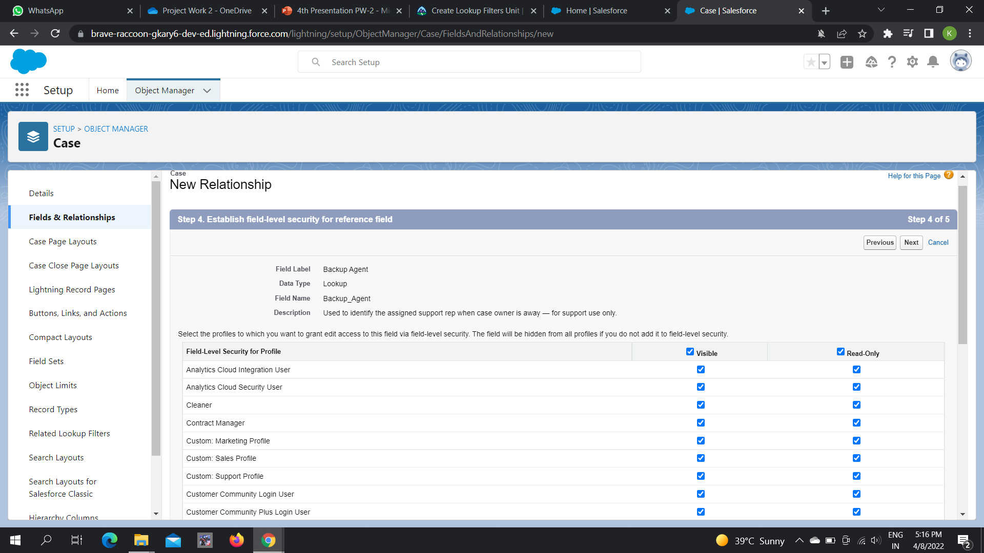

Slide 20
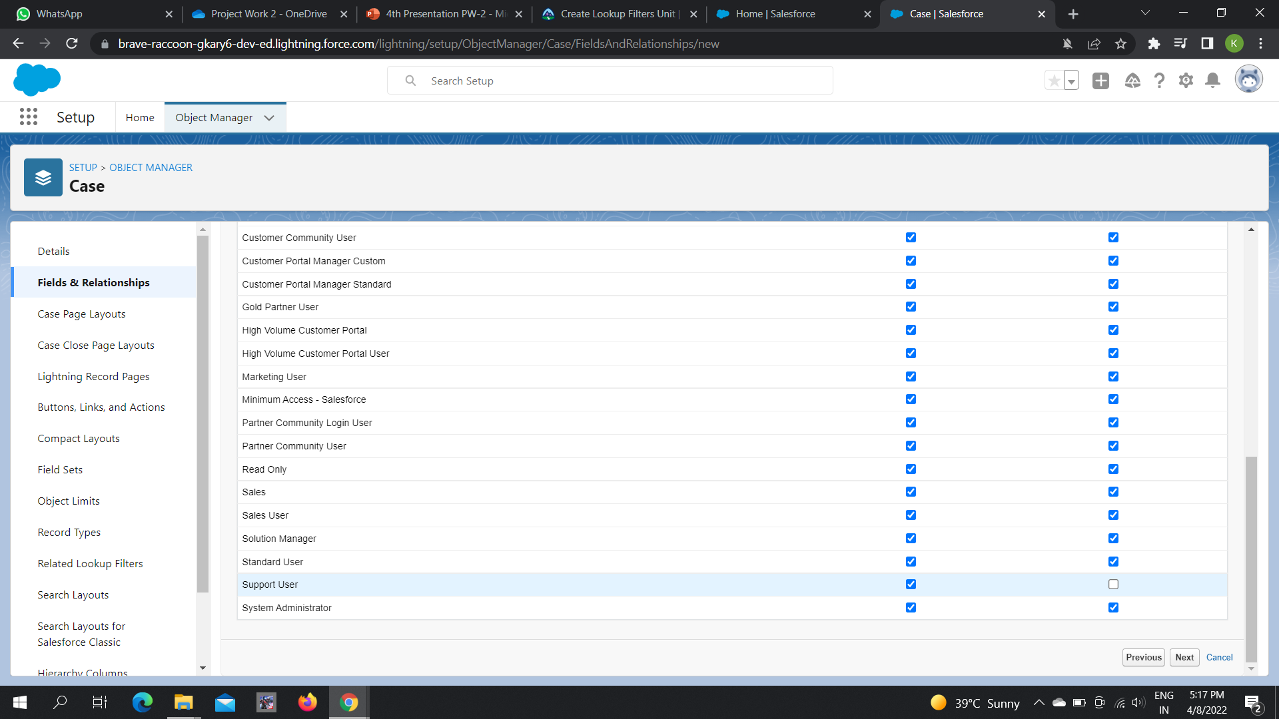

Slide 21
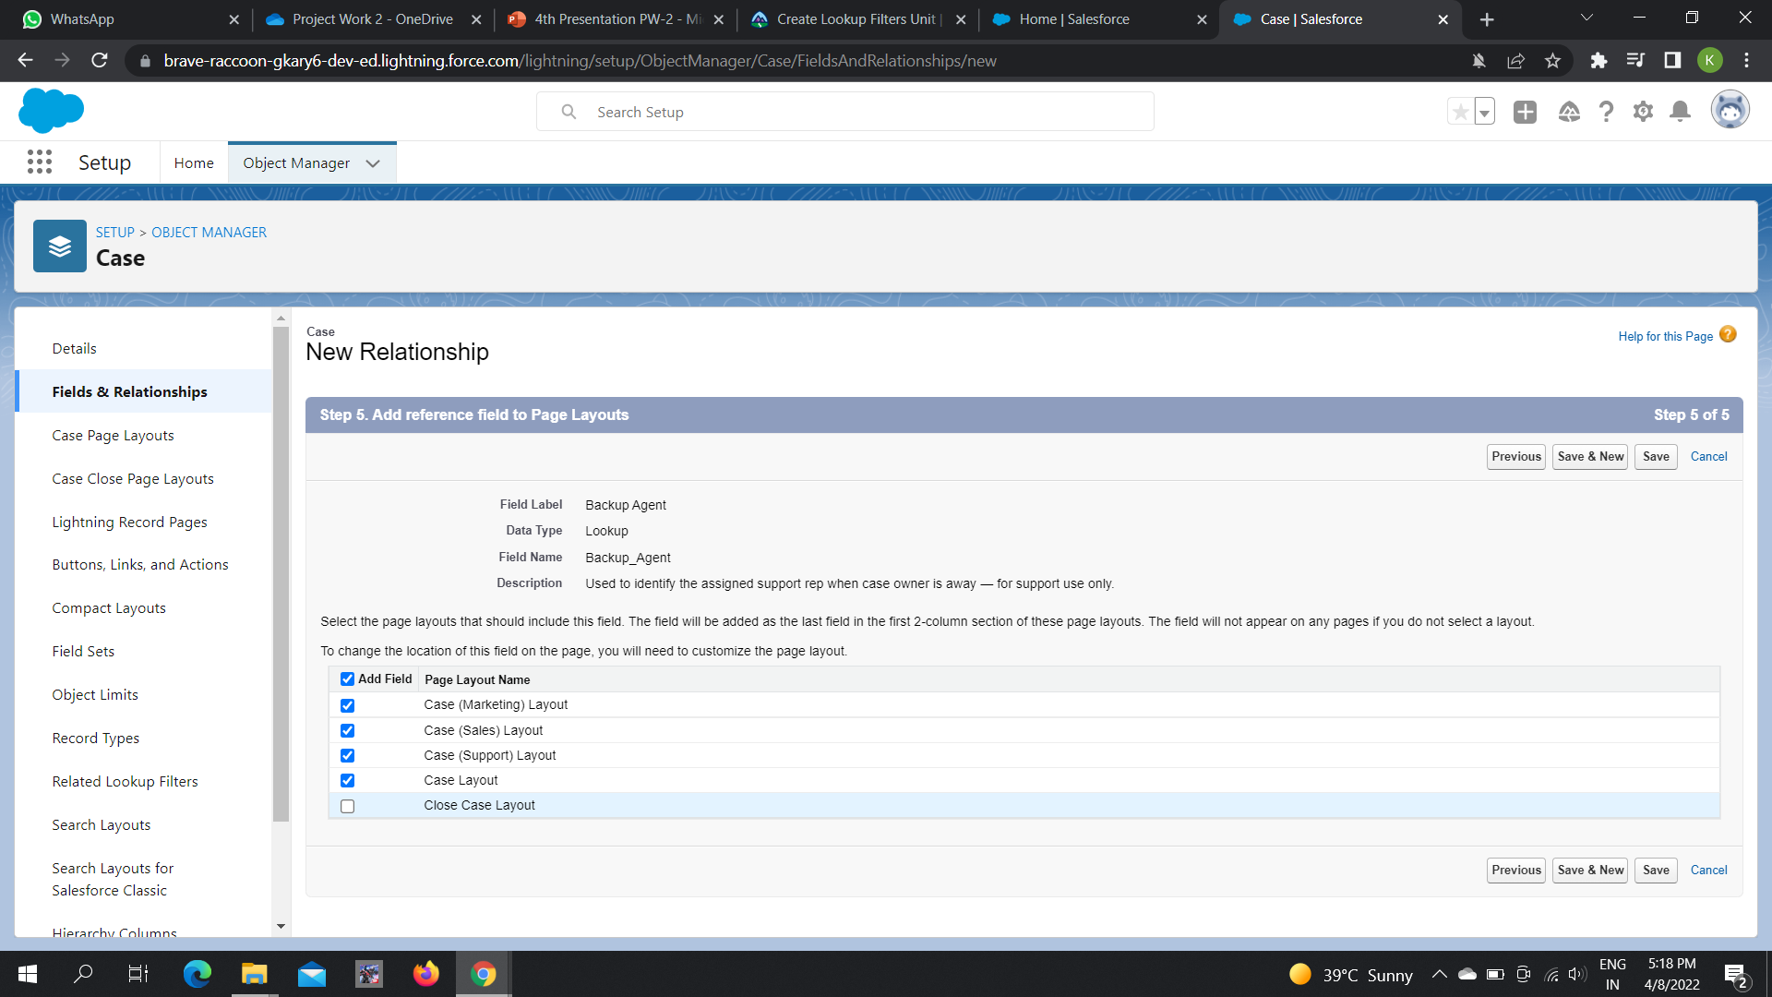

Slide 22
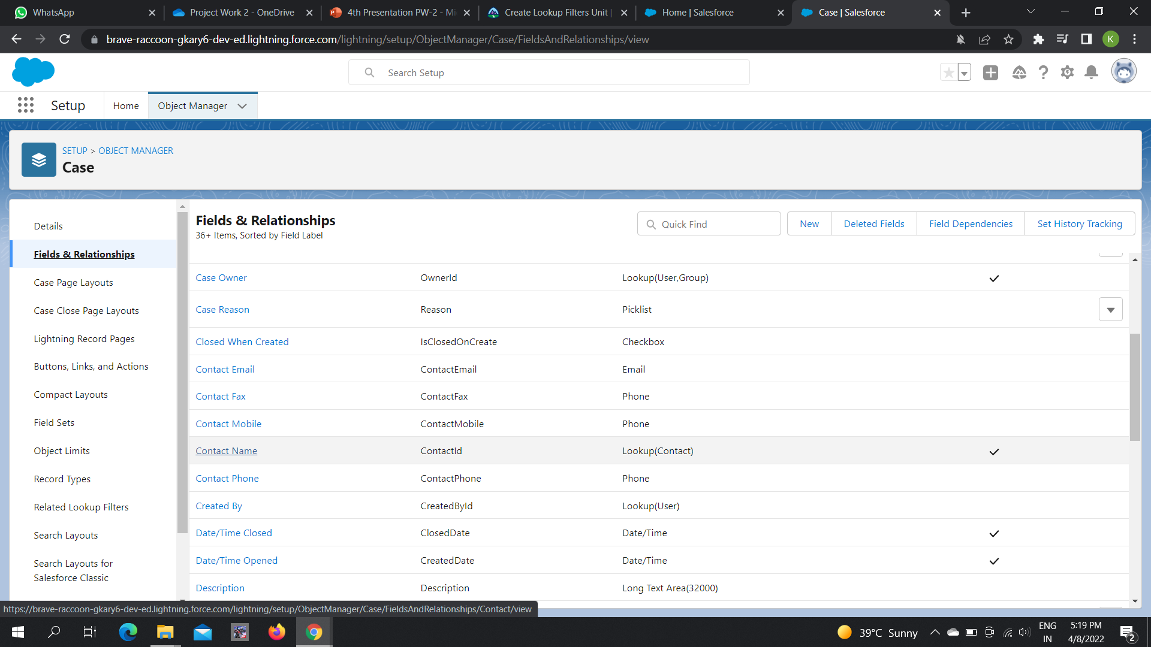

Slide 23
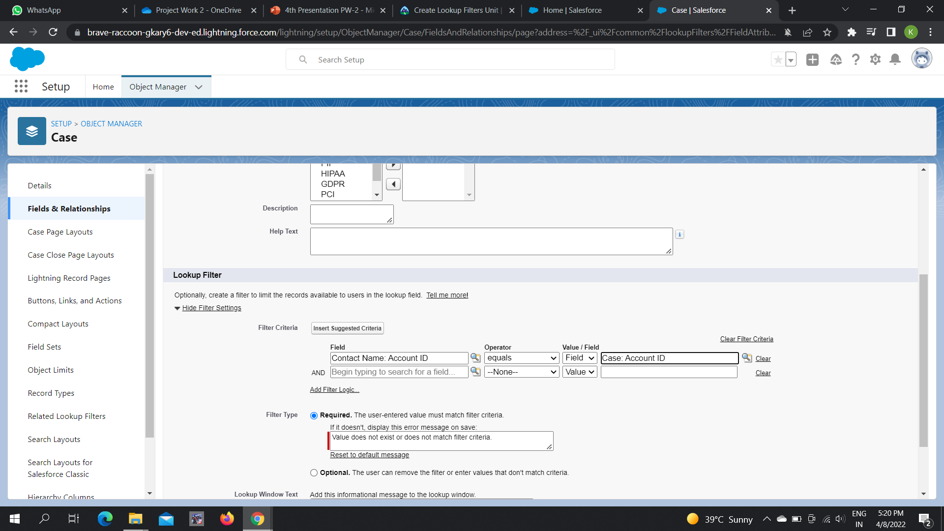

Slide 24
Thank You

